Slide 1







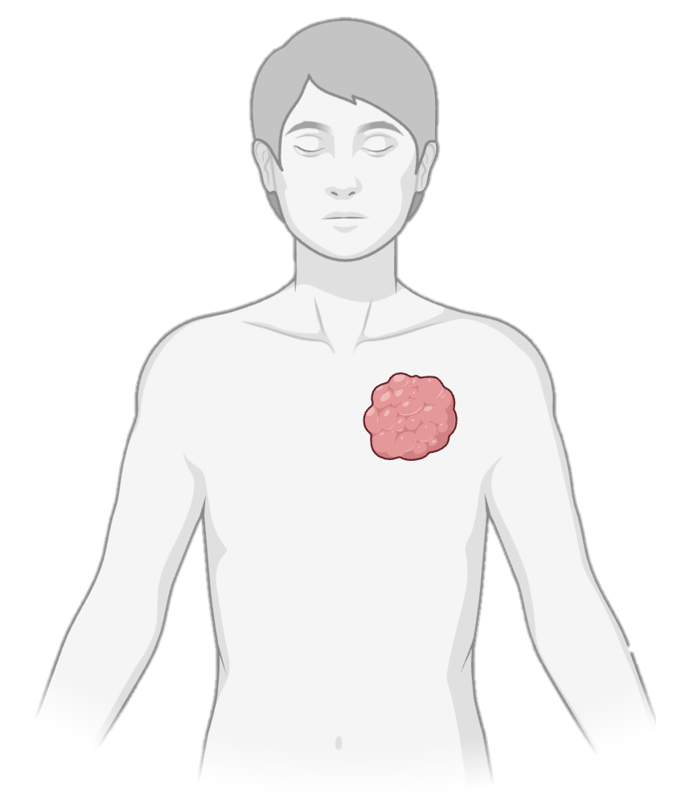

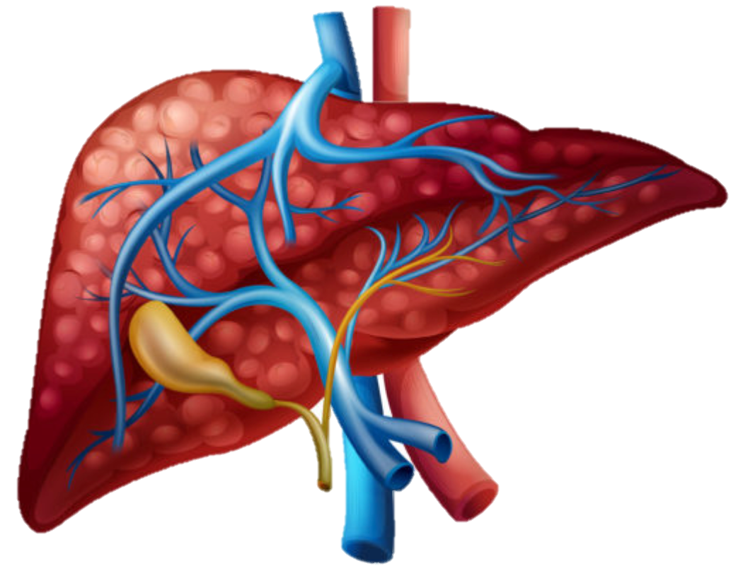
Combination therapy outcomes vary by treatment sequence and baseline risk profiles
Nationwide study (MarketScan database, >250 million individuals)
GLP-1 RA initiators
Statin initiators
Predominant metabolic dysfunction
(obesity, insulin resistance, hyperglycemia)
Predominant cardiovascular risk
(dyslipidemia, atherosclerosis)
MASLD
Population
(multisystem disease)
Add-on GLP-1 RA
Add-on statin
GLP-1 RA initiators → Add-on statin
vs GLP-1 RA monotherapy
Statin initiators → Add-on GLP-1 RA
vs Statin monotherapy
Cirrhosis and Decompensated cirrhosis ~35% risk
Non-liver cancers
~30% risk
Cardiovascular disease
~30% risk
Decompensated
cirrhosis ~20% risk

